Slide 1

OUR JOURNEY
Marek Ivanovič, Samuel Hajný, Barbora Budayová

Slide 2
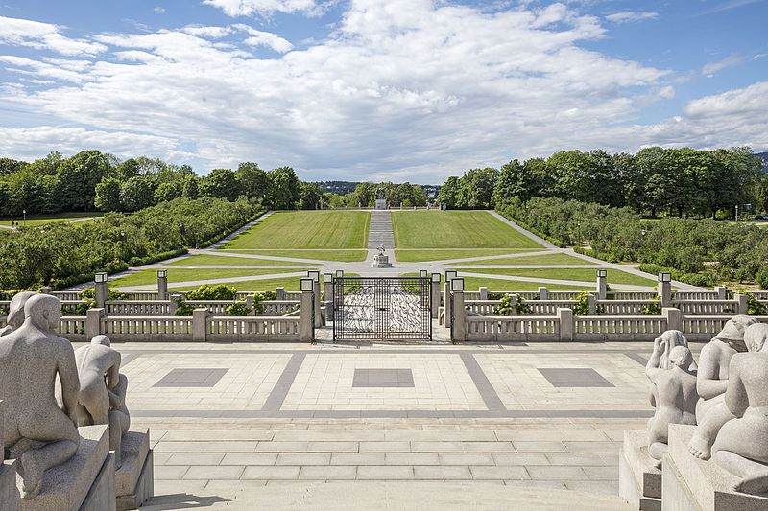
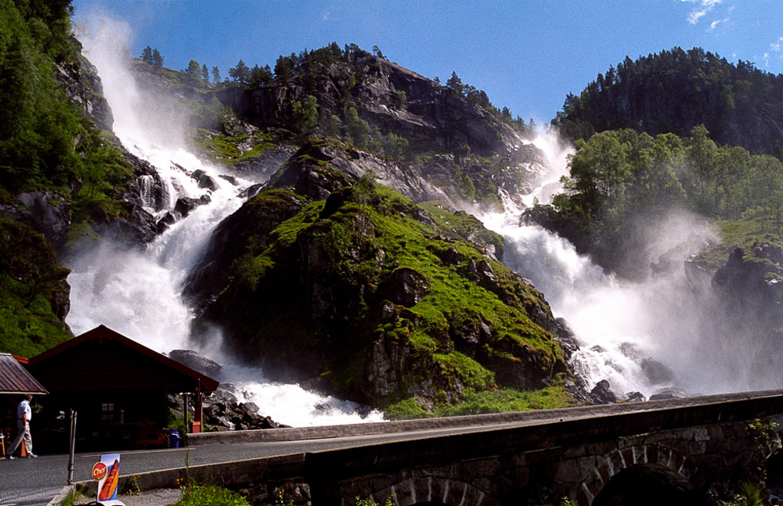
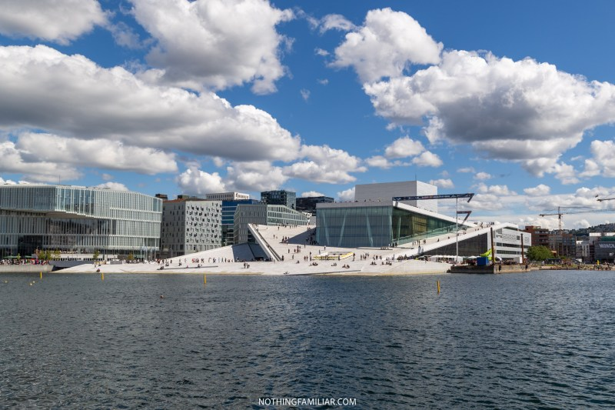
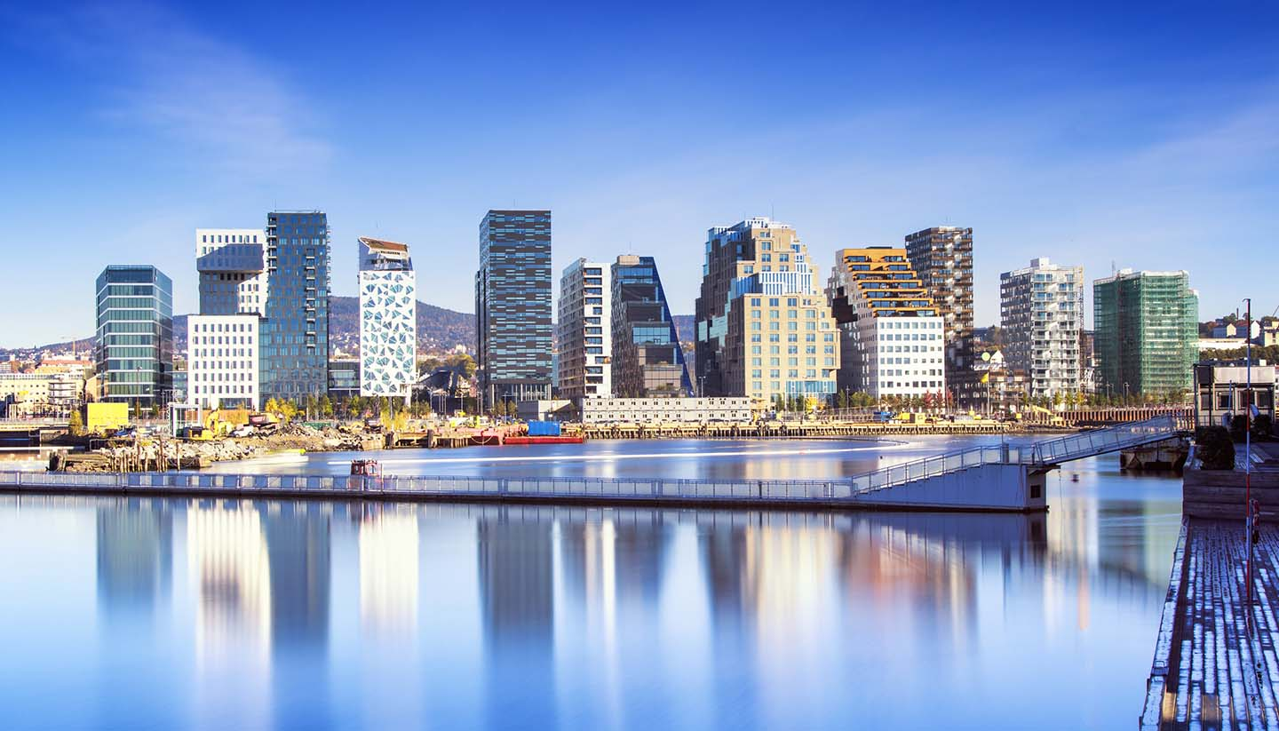
Norway
Waterfall Låtefossen-
The 165-metre tall waterfall
two separate streams flowing down from the lake Lotevatnet, and as they fall, they join in the middle of the waterfall
Oslo-
Capital of Norway,Oslo opera house
Frogner park, largest in a country, lot of sculptures

Slide 3
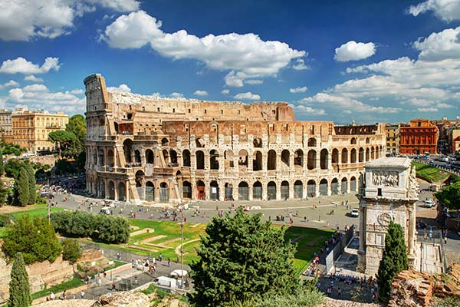
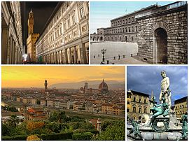
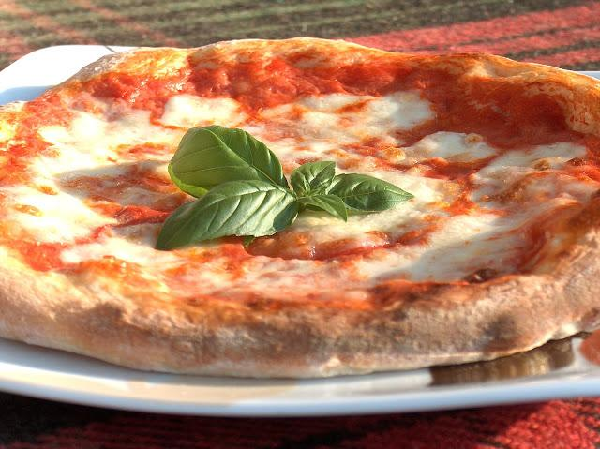
Italy
Roman Colosseum
Largest ancient aphitheatre
Romans organized here gladiator games
Ruined by the earthquakes
There is good cooking (at all in Italy etc.: pizza, spaghetti, pasta)
Florence
Lot of UNESCO sightseens
Considered as the birthplace of the renaissance
Beautiful buildings and scultures

Slide 4
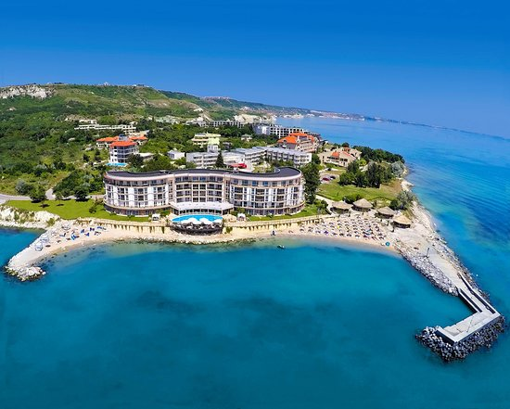
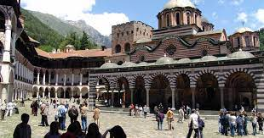
Bulgaria
Kavarna-
Black Sea coastal town with seaside resortes
Place of rich history
There are hotels, restaurants, places of entertainment, casinos, cafes, the visible devaluation of architecture
Monastery Rila-
UNESCO sightseen
Beautiful nature popular among climbers

Slide 5
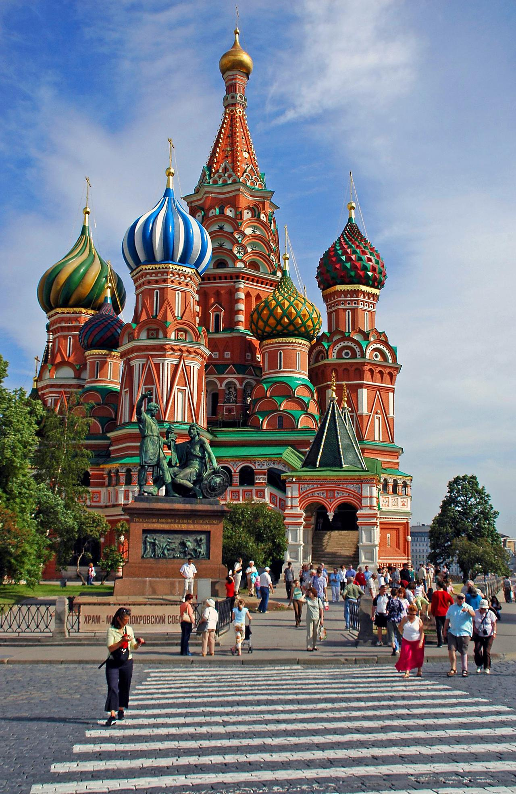
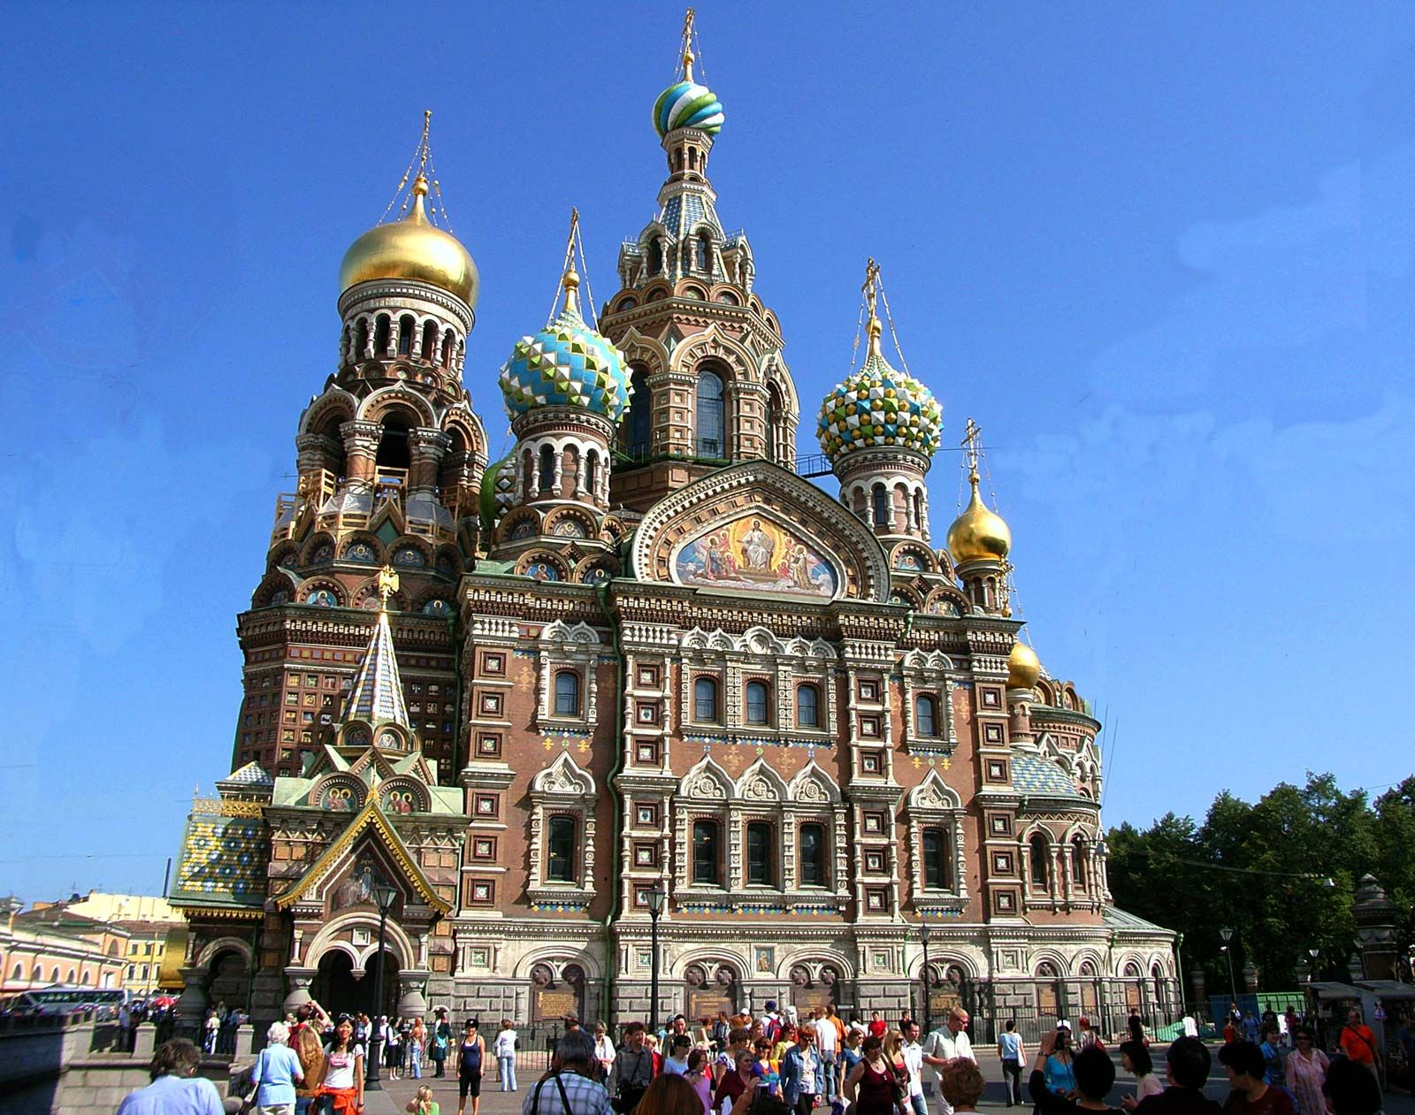
Russia
Moscow-
Capital and largest city of Russia
So many beautiful builldings
Red square
St. Petersburg
Beautiful too

Slide 6


