Slide 1
Trip in Europe
Papučová, Ďurišová, Kubišová

Slide 2
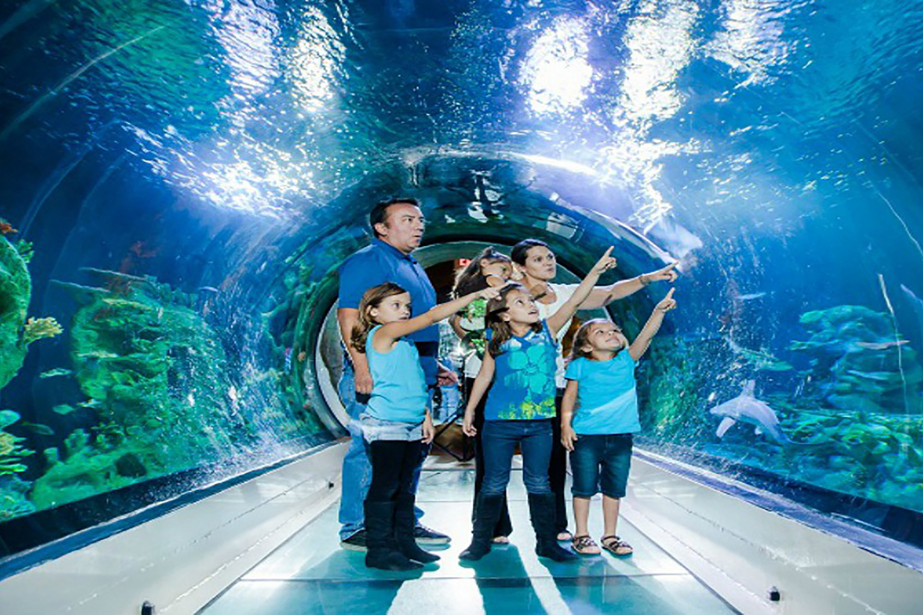
LONDON
London Aquarium - Sea Life
is located in County Hall building on the south bank of the river Thames, next to the London Eye
is open whole week from 10am to 3:45pm
London eye
The London Eye is located on the south bank of the river Thames
one ride takes 30 minutes, there is 32 high-tech glass

Slide 3
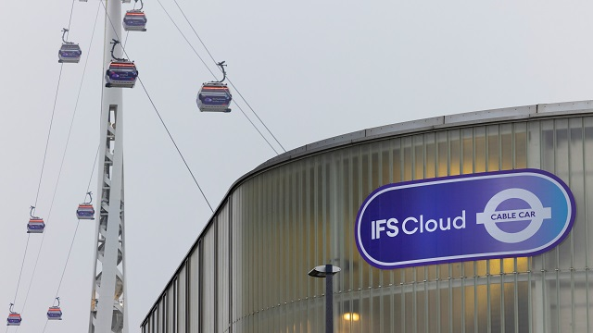
Madame Tussauds London
Madame Tussauds London is located on Marylebone Road in Marylebone, north-west London
You should allow one-and-a-half to two hours to complete your visit to Madame Tussauds London
IFS Cloud Cable Car
Glide above the Thames in the IFS Cloud Cable Car and take in aerial views of London's skyline
ride usually take about 10 minutes.

Slide 4
portugal
The Azores,Portugal
The Azores are best known for whales and dolphin watching.
July and August are the best times to visit Azores
It´s also known for hiking,diving to other adventure sports
Lisbon,Portugal
It´s the capital and the largest city o Portugal
It has the worlds oldest bookstore
Its known for its colonialist history and ornate architecture and beaches

Slide 5
The Algarve
Its famous for its cliff-backed beaches,mouthwatering seafood and picturesque villages.
The region has a warm climate and is famous for its popularity as holiday destination.
The are many golf courts along the coast

Slide 6
Paris
Louvre:
Is an iconic French palace
It was using intermittently for a royal family between 14th and 18th centuries
Now it is mostly used by the Louvre Museum, which was first opened in 1793
It´s the third biggest museum in the World

Slide 7
Eiffel tower:
Was built between 1887 and 1889
There were 50 architects, engineers and draftsmen that created 5300 drawings o the tower before the construction started
It´s 324m tall and it weight more that 10tons
Eiffel tower now cost more than 80milion euros
Arc de Triomphe:
One o the most famous monuments in Paris
Construction started on 15 o August 1806 an it ended on July 29 1836
It´s made o limestone and cubblestone
Bou need to climb 284 steps to reach the top o the Arc de Triomphe

