Slide 1
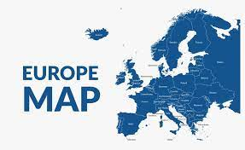
Places to vist in Europe
Places to visit in Europe

Slide 2

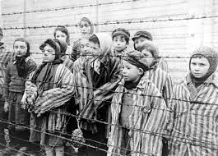
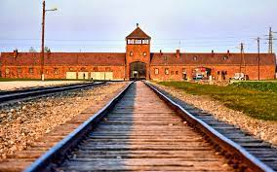
Auschmitz
1.1 milion people died in auschmitz
It takes two and a half hour from Považská Bystrica to auschmitz to get there
I would like to go there for the historical part of it
The jews got there by train
The capital city of Poland is Warsav

Slide 3

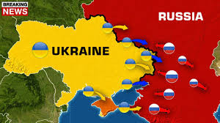
ukraine
-Ukraine covers approximately 600,000 square kilometres
-41 milion people live there
-there is an ongoing war with russia
-The capital city of Ukraine is Kyev

Slide 4


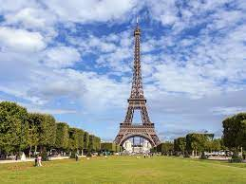
France
The capital city is paris
Most famous place to visit is eifell
tower
-famous food is baguette and
croasiant

