Slide 1
Trip around the Europe
-Germany
-France
-Slovenia
-Finland

Slide 2
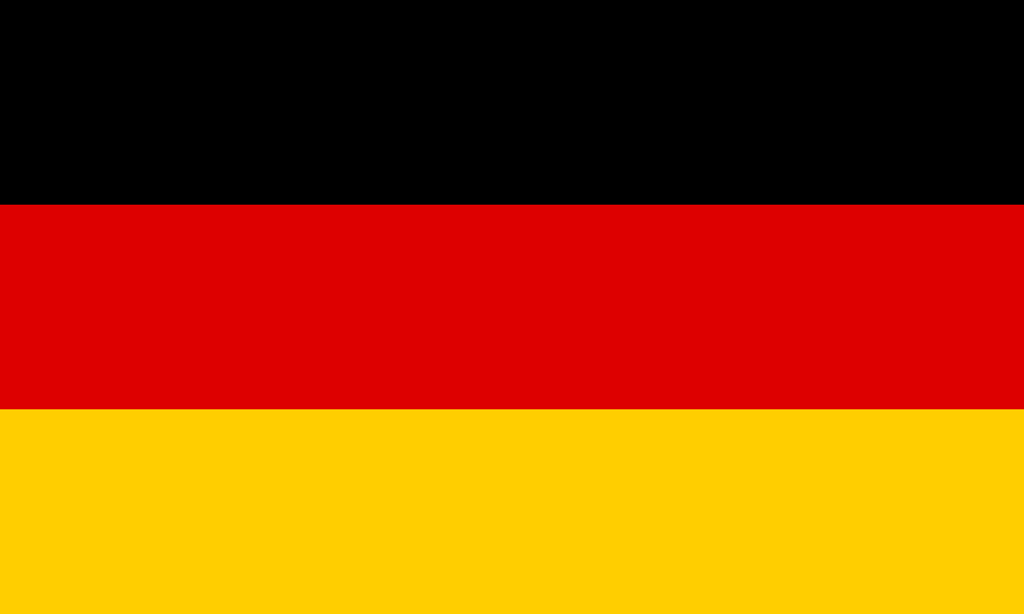
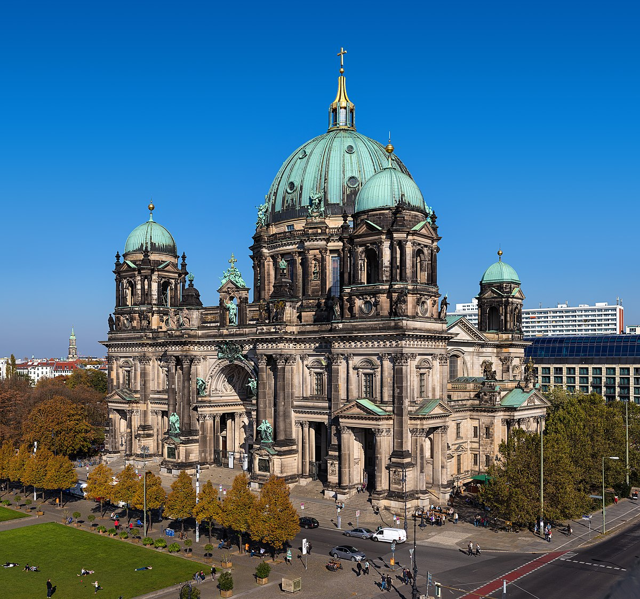
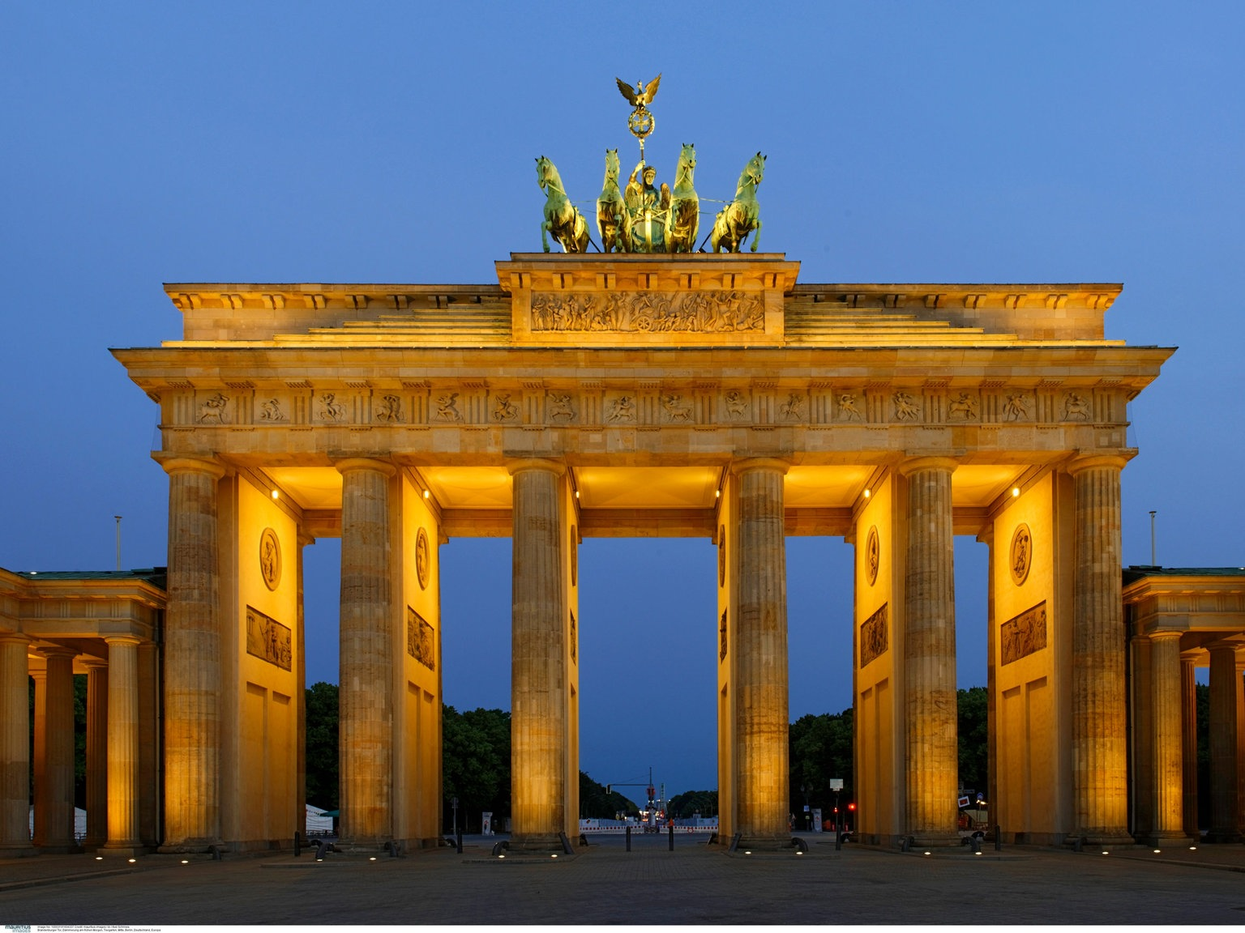
Germany
Germany
We want to visit Germany because it‘s very expensive country and visit the capital city of Germany-Berlin. In Berlin we want to see Brandenburg Gate, visit Großer Tiergarten and Berlin cathedral too.

Slide 3

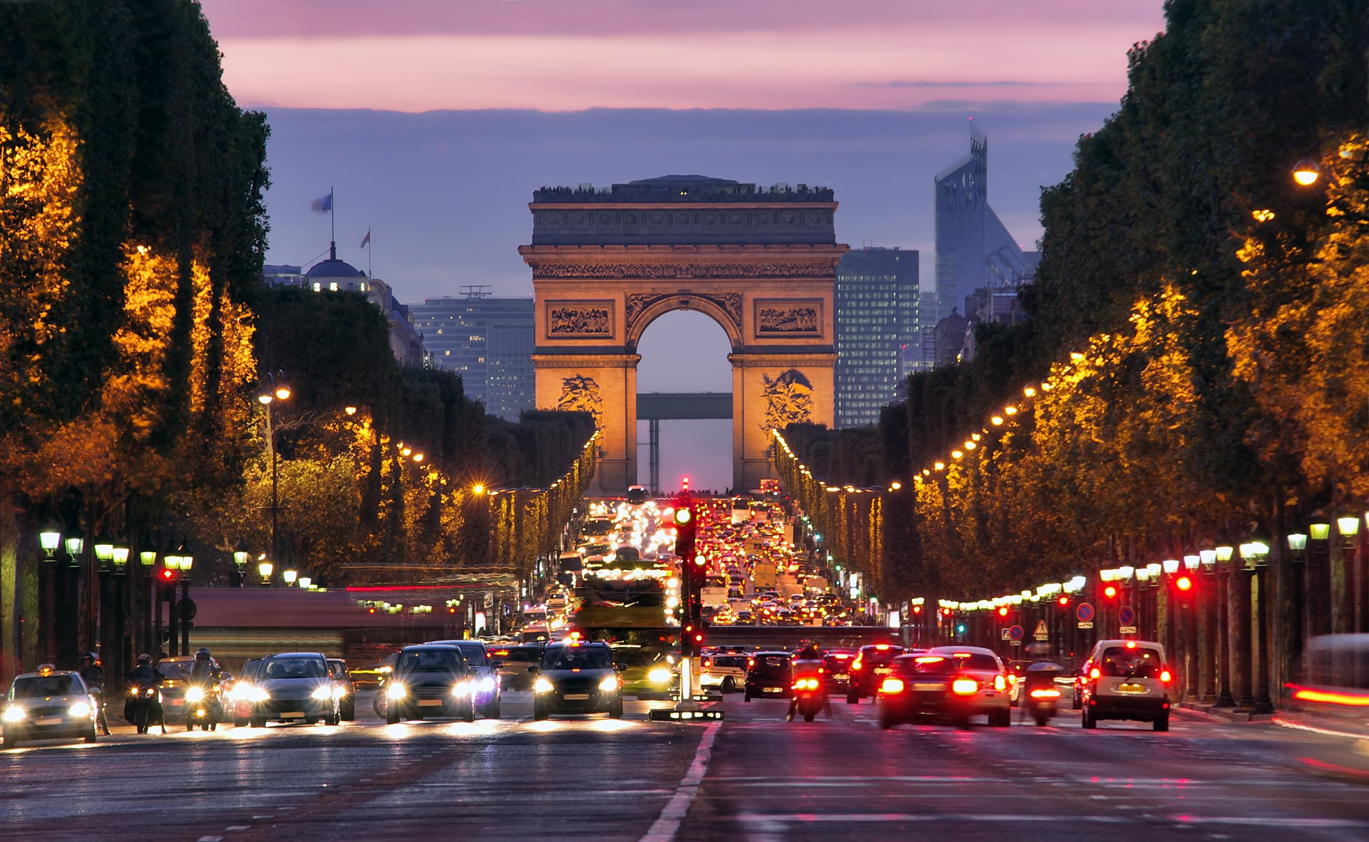
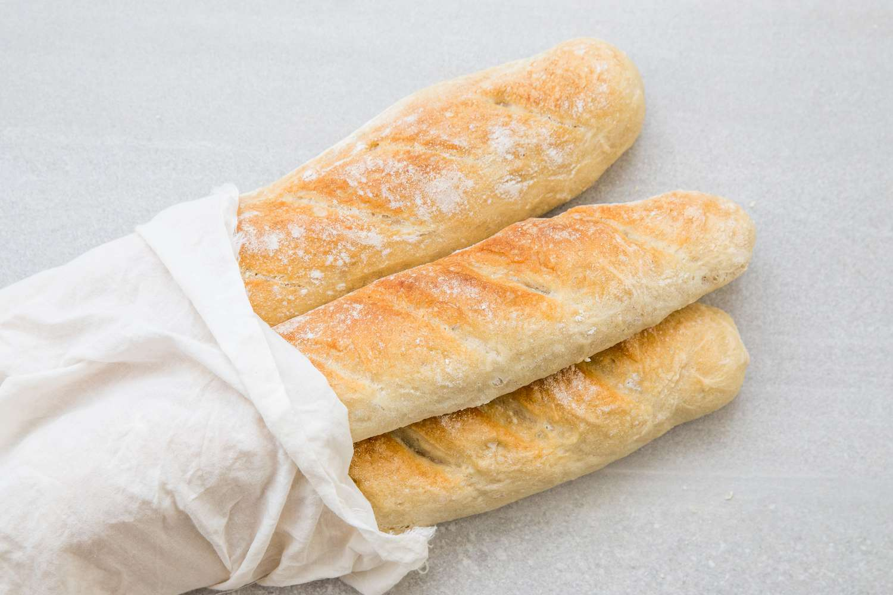
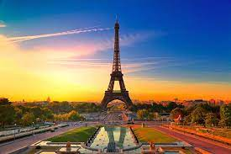
France
All of us want to see Eiffel Tower and visit Arc de Triomphe de l’Étoile.
Then we want to see Lascaux caves and enjoy the coast of france next to the Mediterranean sea.

Slide 4

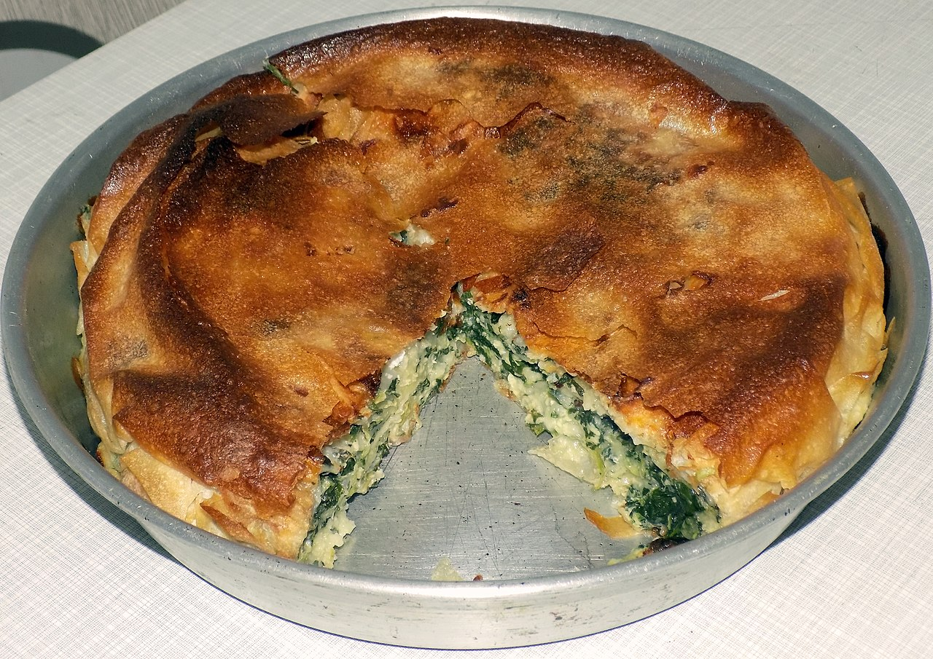
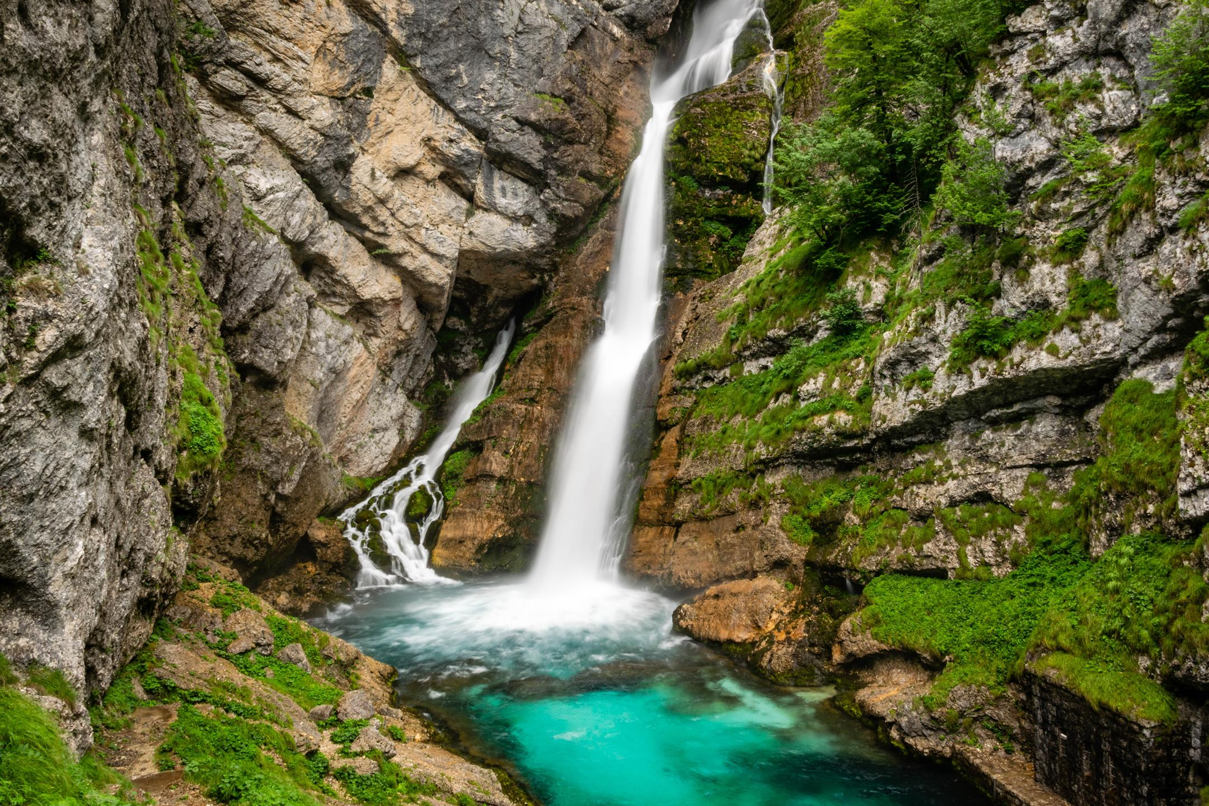
Slovenia
Slovenia has beautiful nature and we want to see Savica waterfall.
Then we will eat Burek-traditional Slovenian food.
Ski races are organized in Slovenia several years.

Slide 5

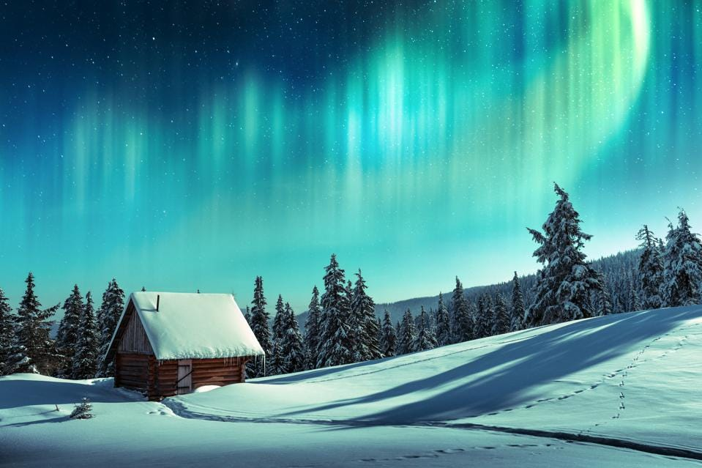
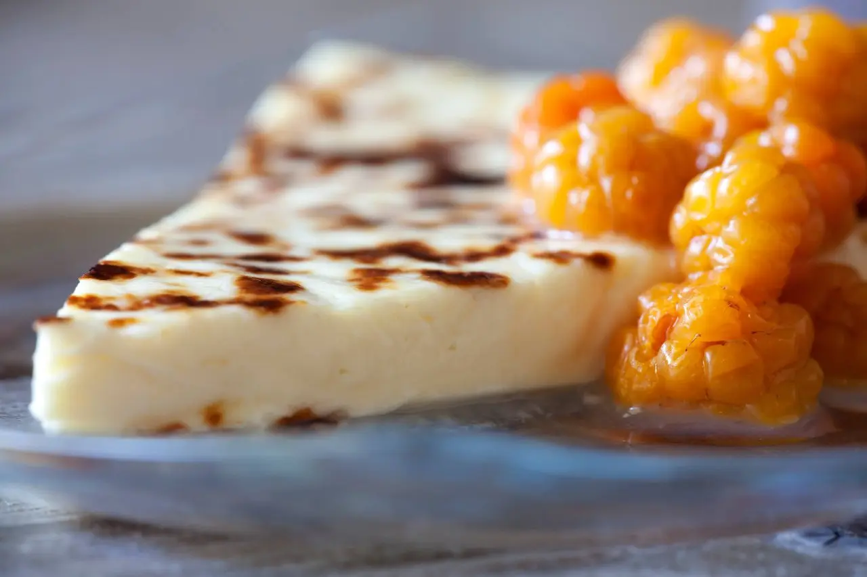
Finland
we decided to visit Finland for its beautiful snowy landscape and because the legend about Santa living in Lapland.
After that we will eat Finland food Leipäjuusto-Bread cheese or Finnish squeaky cheese.

