Slide 1
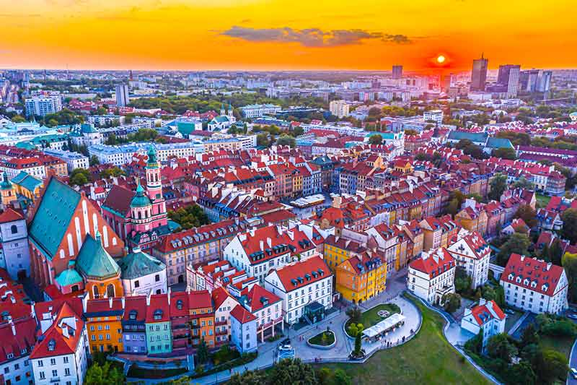
POLAND

Slide 2
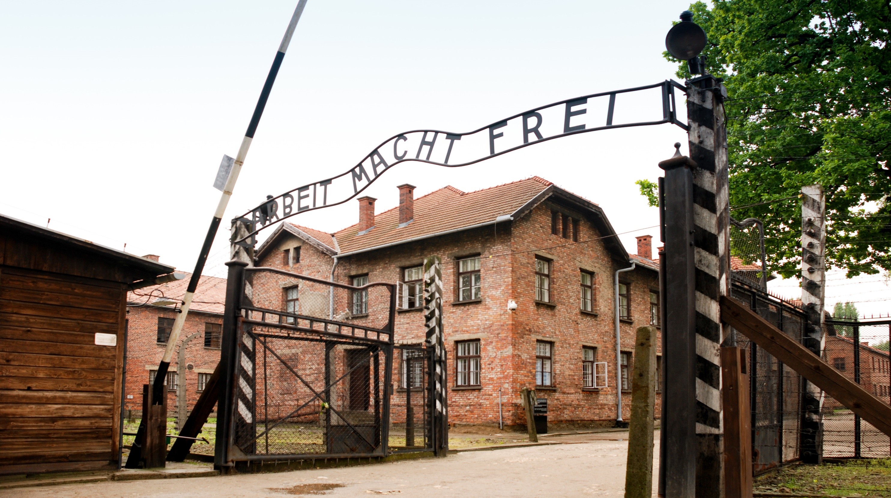
Auschwitz
The ride is 2hours and 30 minutes About 1.1 milion people died
Construction of the camp began in October 1941 on the territory of the Upper Silesian village of Brezinka

Slide 3
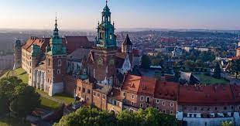
Wawel Castle
Wawel Castle is a Gothic castle on the Wawel Hill in Krakow, built on the orders of Casimir III.

Slide 4

croatia
population of nearly 3.9 million
The Croats arrived in the late 6th century
Capital city- zagreb

Slide 5

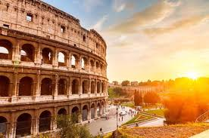

ITALIA
ITALIA
Capital city- rím

